Slide 2
Angular Ahead-of-time Compiler

Slide 3
Agenda
Angular Compilation
JIT vs AOT
Why compile with AOT

Slide 4
Angular – AOT Compiler
An Angular application consists mainly of components and their HTML templates. Because the components and templates provided by Angular cannot be understood by the browser directly, Angular applications require a compilation process before they can run in a browser.
The Angular Ahead-of-Time (AOT) compiler converts Angular HTML and TypeScript code into efficient JavaScript code during the build phase before the browser downloads and runs that code. Compiling application during the build process provides a faster rendering in the browser.

Slide 5


Angular – AOT Compiler
Angular Compilation
In Angular, there are two ways to compile your application:
Just-in-Time (JIT), which compiles application in the browser at runtime.
Ahead-of-Time (AOT), which compiles application at build time.
JIT compilation is the default when we run the ng build (build only) or ng serve (build and serve locally) CLI commands:
For AOT compilation, include the --aot option with the ng build or ng serve command:

Slide 6
Angular – Compiler
Just-In-Time | Ahead-Of-Time
Loads the application slower than AOT since it needs to compile the application when running for the first time. | Loads the page more quickly than JIT compilation.
It download the compiler and compiles the application before displaying. | It doesn’t want to download the compiler, since AOT already compiles the code when building the application.
Since the code include the compiler code also the bundle size will be higher. | Since it created fully compiled code and its optimized so it bundle size will be half the bundle size compiled by JIT.
Suitable in development mode. | Suitable in the case of production.
Following command use JIT ng build, ng server. | Following command use AOT ng build –aot, ng serve –aot, ng build –prod.
Template binding errors can be viewed at the time of displaying the application. | Template binding errors are shown at the time of building.

Slide 7
Angular – AOT Compiler
Why compile with AOT
Faster rendering
With AOT, the browser downloads a pre-compiled version of the application. The browser loads executable code so it can render the application immediately, without waiting to compile the app first.
Fewer asynchronous requests
The compiler inlines external HTML templates and CSS style sheets within the application JavaScript, eliminating separate Ajax requests for those source files.
Smaller Angular framework download size
There's no need to download the Angular compiler if the app is already compiled. The compiler is roughly half of Angular itself, so omitting it dramatically reduces the application payload.

Slide 8
Angular – AOT Compiler
Detect template errors earlier
The AOT compiler detects and reports template binding errors during the build step before users can see them.
Better security
AOT compiles HTML templates and components into JavaScript files long before they are served to the client. With no templates to read and no risky client-side HTML or JavaScript evaluation, there are fewer opportunities for injection attacks.

Slide 9
Angular – AOT Compiler
When you use the Angular AOT compiler, can control application compilation in two ways:
By specifying Angular metadata.
By providing template compiler options in the tsconfig.json file.

Slide 10
Angular – AOT Compiler
Specifying Angular Metadata
Angular metadata tells Angular how to construct instances of application classes and interact with them at runtime. The Angular AOT compiler extracts metadata to interpret the parts of the application that Angular is supposed to manage.
We can specify the metadata with decorators such as @Component() and @Input() or implicitly in the constructor declarations of these decorated classes.
In the following example, the @Component() metadata object and the class constructor tell Angular how to create and display an instance of TypicalComponent.

Slide 11
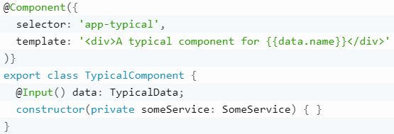
Angular – AOT Compiler
The Angular compiler extracts the metadata once and generates a factory for TypicalComponent. When it needs to create a TypicalComponent instance, Angular calls the factory, which produces a new visual element, bound to a new instance of the component class with its injected dependency.

Slide 12
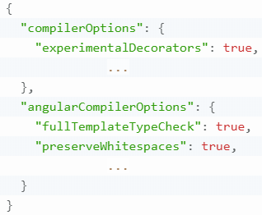
Angular – AOT Compiler
Angular template compiler options
The template compiler options are specified as members of the "angularCompilerOptions" object in the tsconfig.json file. Specify template compiler options along with the options supplied to the TypeScript compiler as shown here in this example code:

Slide 13
Thank You

